Slide 1
Python Functions

Slide 2
Syllabus Content
Functions
Advantages of Functions
Built-in Functions and User-Defined Functions
Anonymous Functions
Pass by Value Vs Pass by Reference
Recursion
Scope and Lifetime of Variables

Slide 3
Function
A function is a block of code that performs a specific task.
Suppose, you need to create a program to create a circle and color it.
You can create two functions to solve this problem:
create a circle function
create a color function
Dividing a complex problem into smaller chunks makes our program easy to understand and reuse.
A function is a block of code which only runs when it is called.
You can pass data, known as parameters, into a function.
A function can return data as a result.

Slide 4
Types of function
There are two types of function in Python programming:
Standard library functions - These are built-in functions in Python that are available to use.
User-defined functions - We can create our own functions based on our requirements.

Slide 5
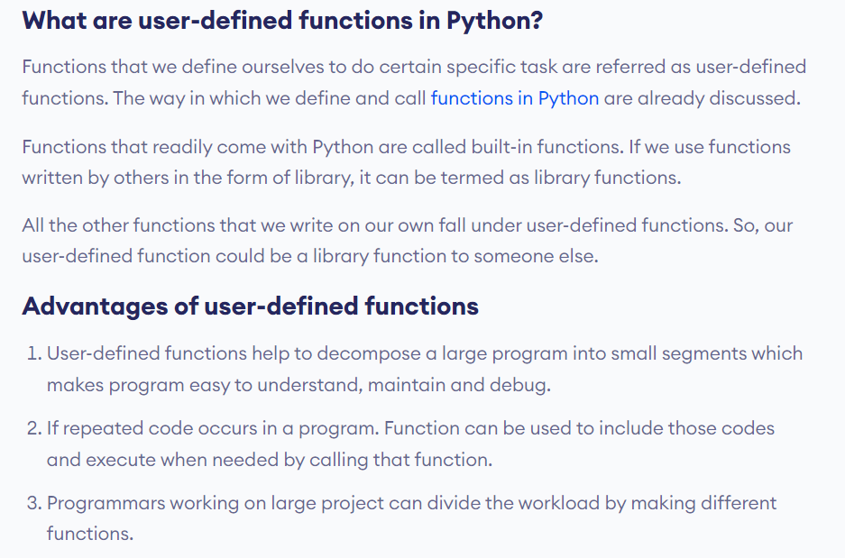

Slide 6
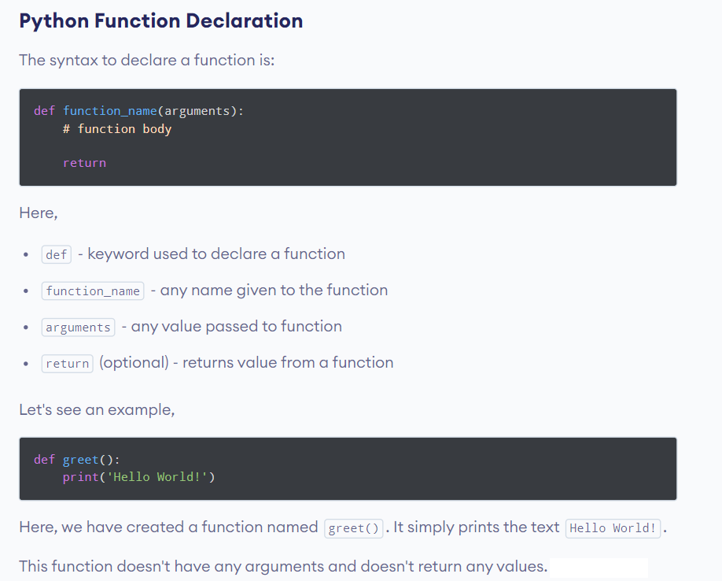

Slide 7
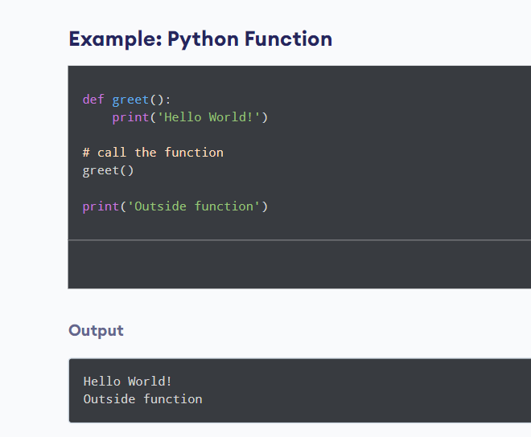
Calling a Function in Python

Slide 8
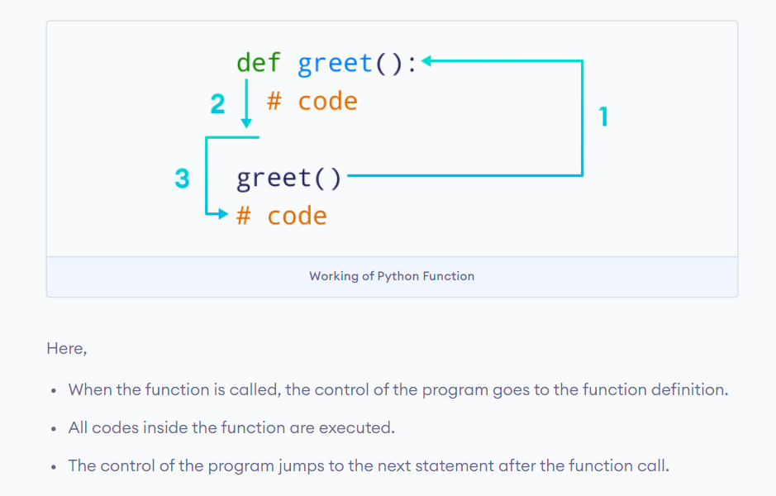
Working of Python Function

Slide 9
Arguments
Information can be passed into functions as arguments.
Arguments are specified after the function name, inside the parentheses.
You can add as many arguments as you want, just separate them with a comma.

Slide 10
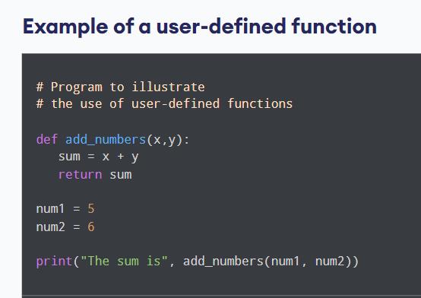

Slide 11
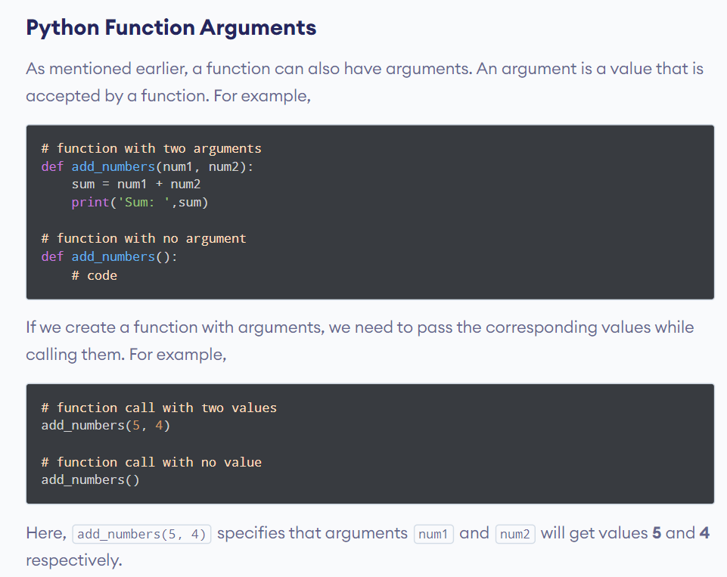

Slide 12
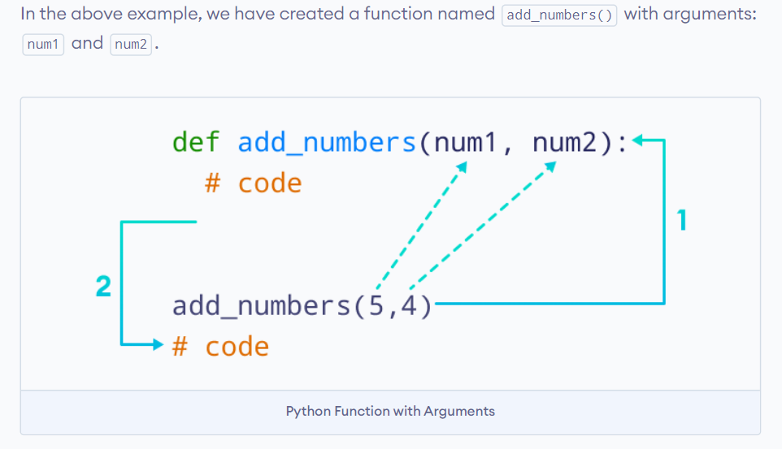
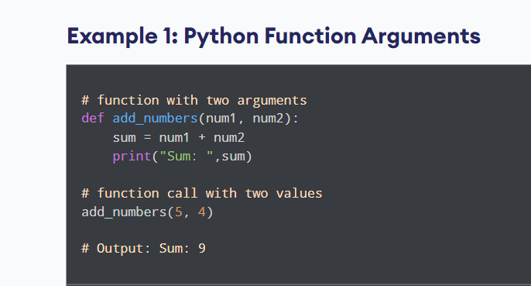

Slide 13
Parameters or Arguments?
The terms parameter and argument can be used for the same thing: information that are passed into a function.
From a function's perspective:
A parameter is the variable listed inside the parentheses in the function definition.
An argument is the value that is sent to the function when it is called.

Slide 14
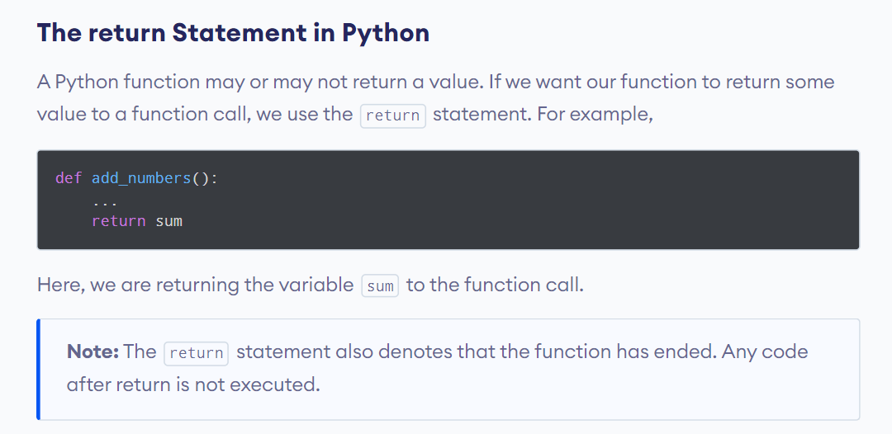

Slide 15
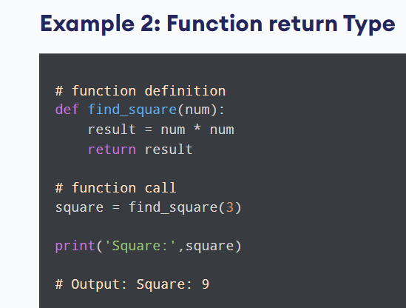
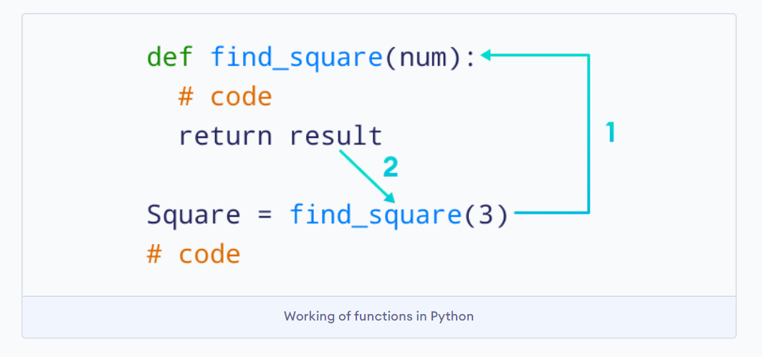

Slide 16
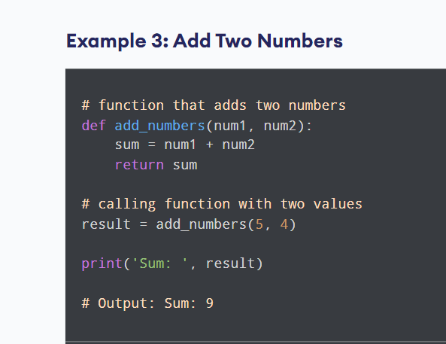

Slide 17
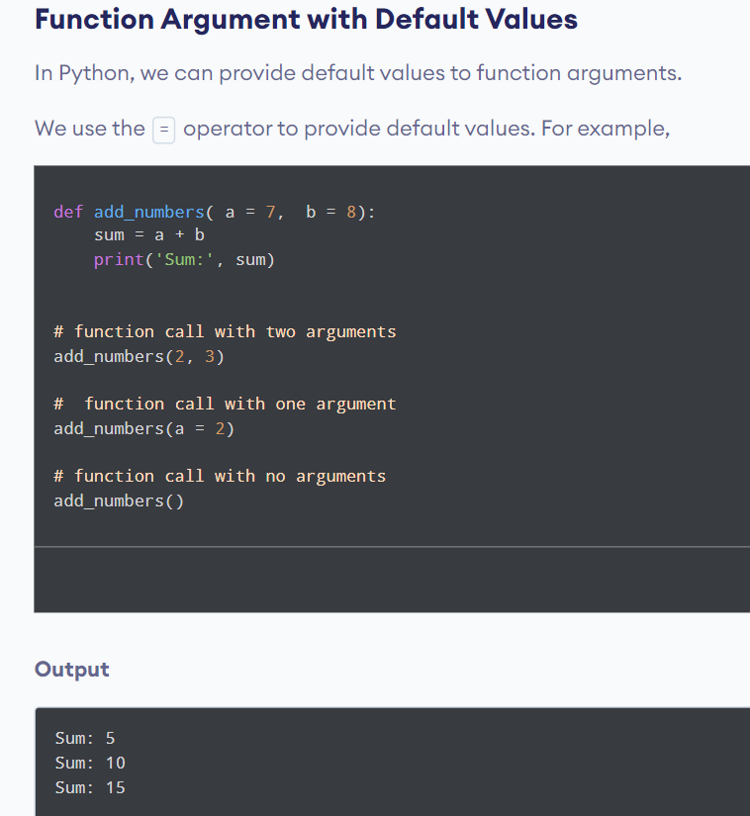

Slide 18
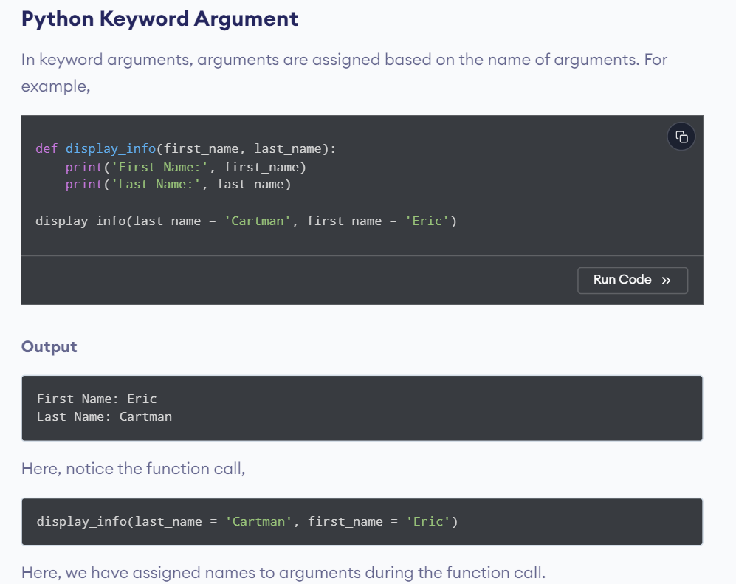

Slide 19
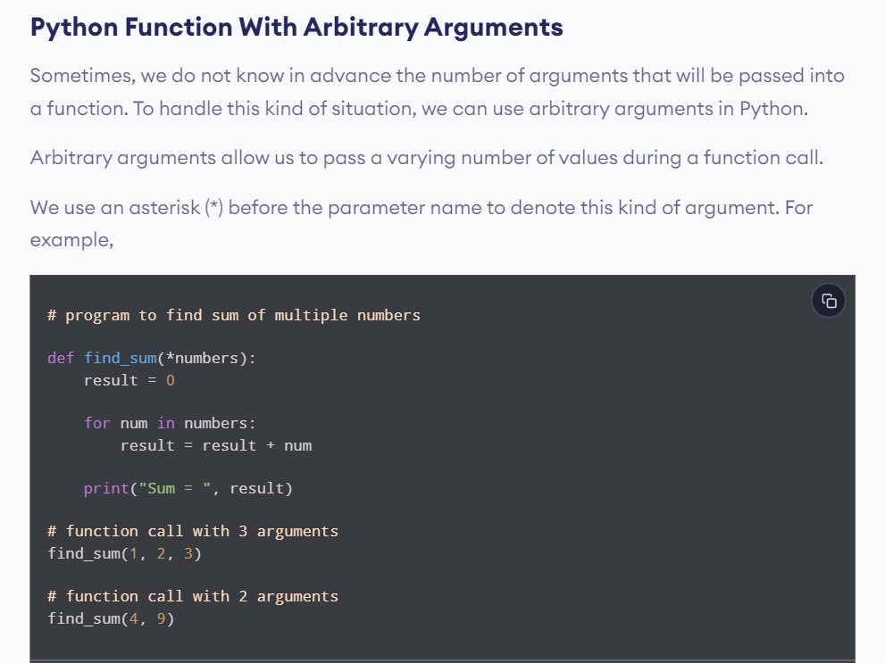

Slide 20
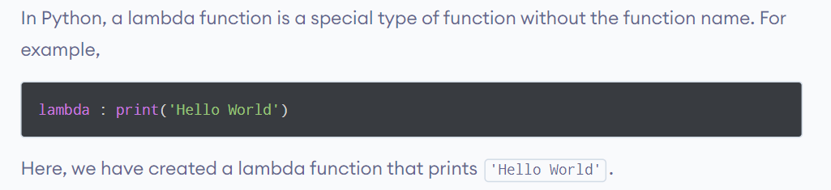
Python Lambda/Anonymous Function

Slide 21
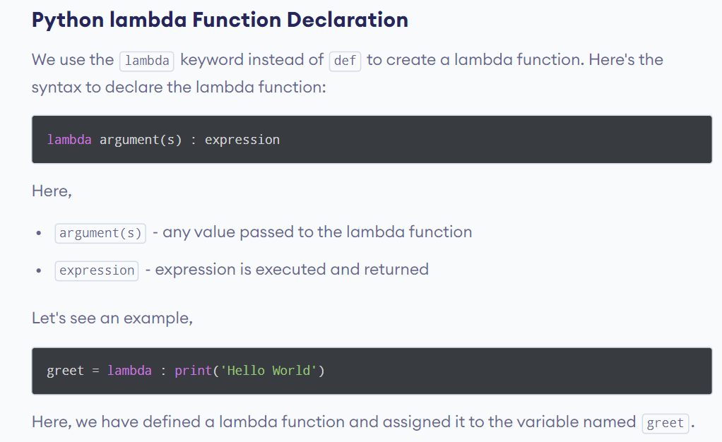

Slide 22
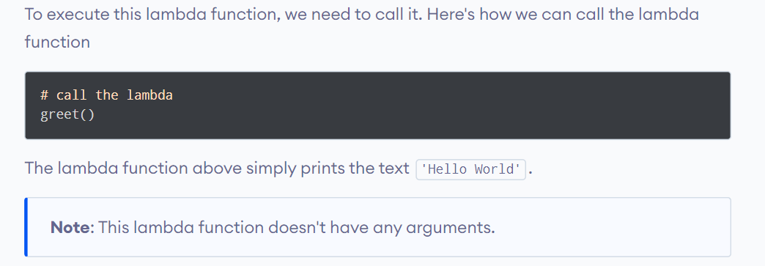

Slide 23
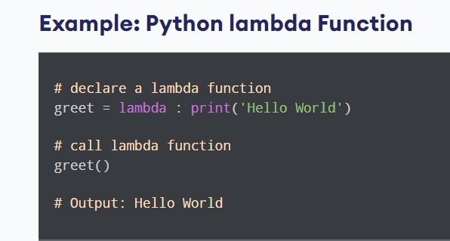

Slide 24
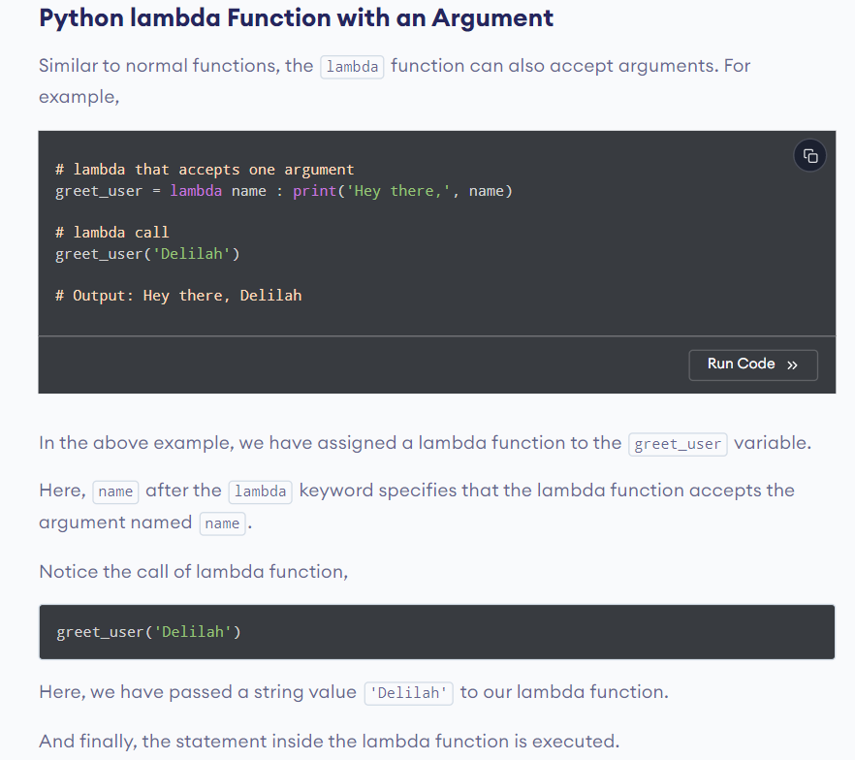

Slide 25
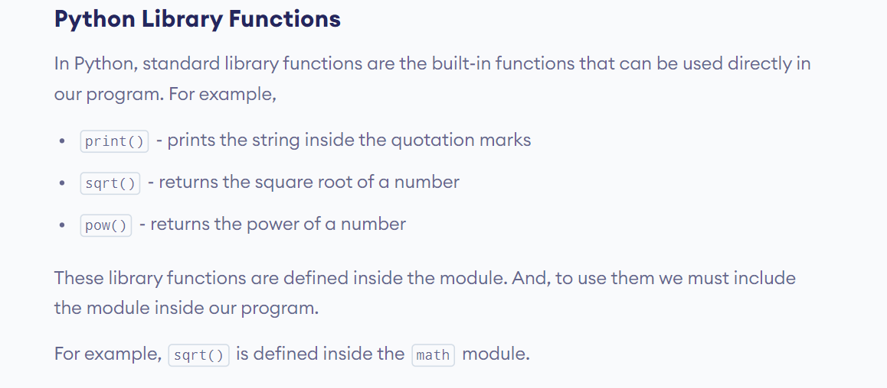

Slide 26
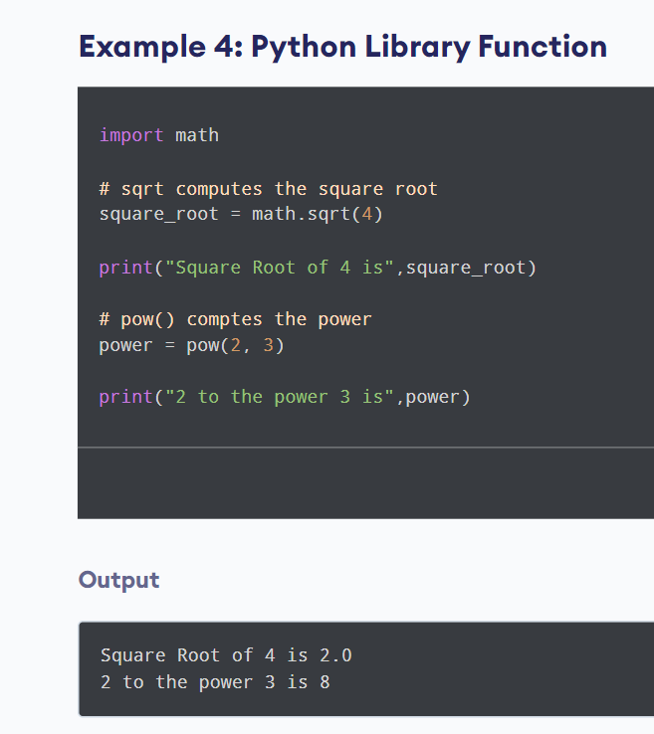

Slide 27
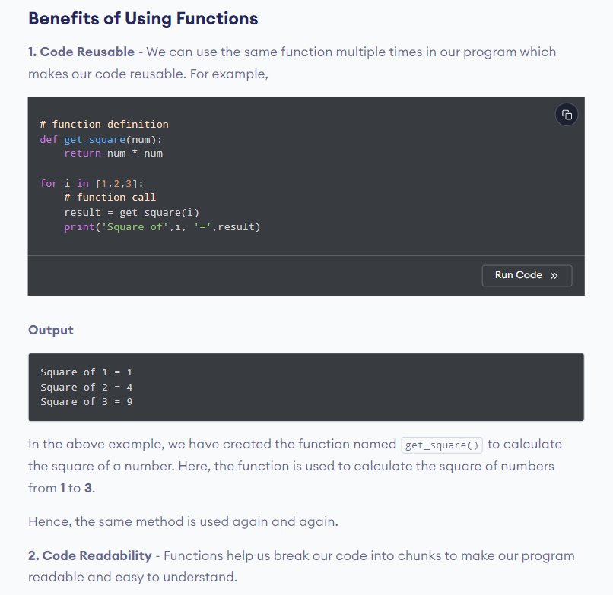

Slide 28
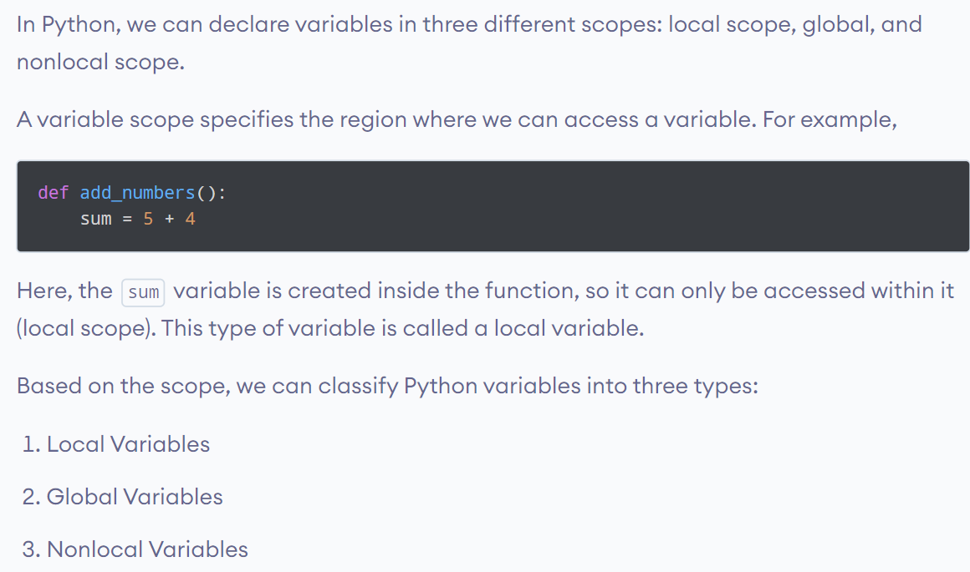
Python Variable Scope: Python Global variables, Local variables, and Nonlocal variables

Slide 29
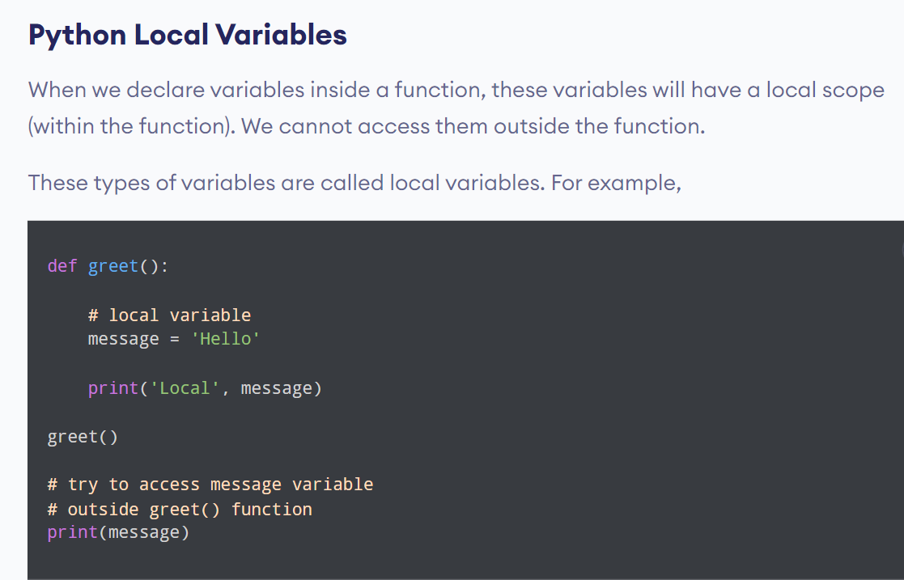

Slide 30
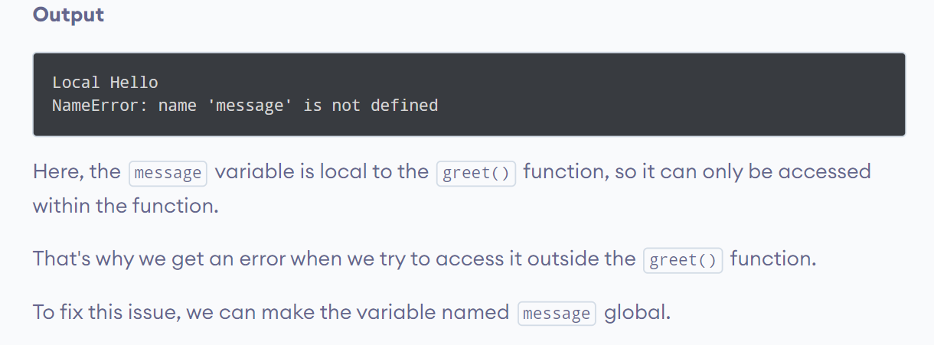

Slide 31
Python Global Variables
In Python, a variable declared outside of the function or in global scope is known as a global variable.
This means that a global variable can be accessed inside or outside of the function.

Slide 32
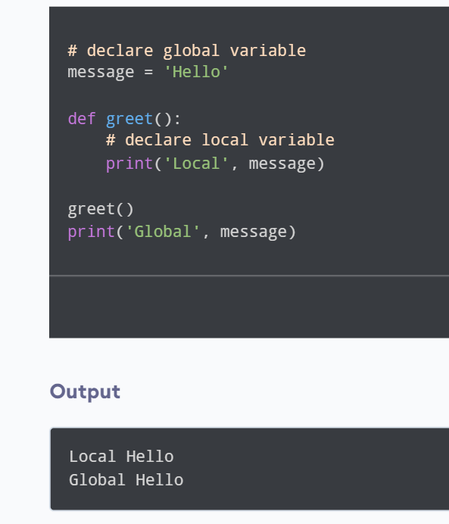

Slide 33
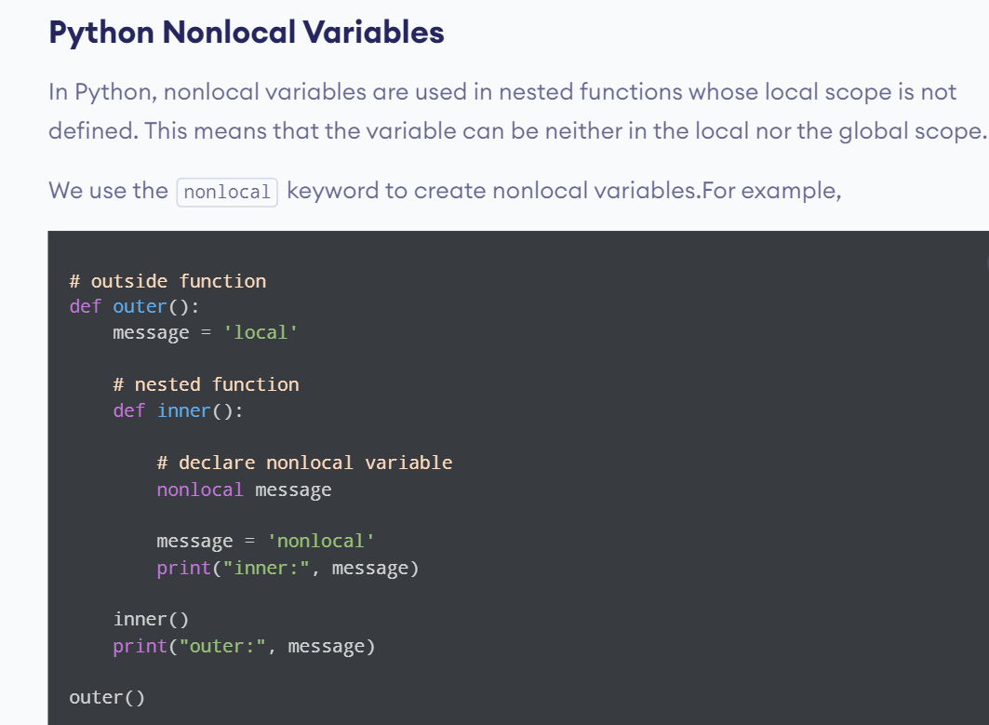

Slide 34
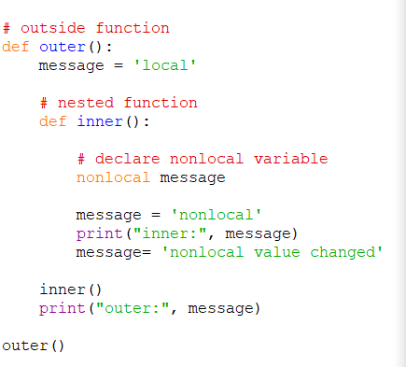
If we change the value of a nonlocal variable, the changes appear in the local variable.

Slide 35
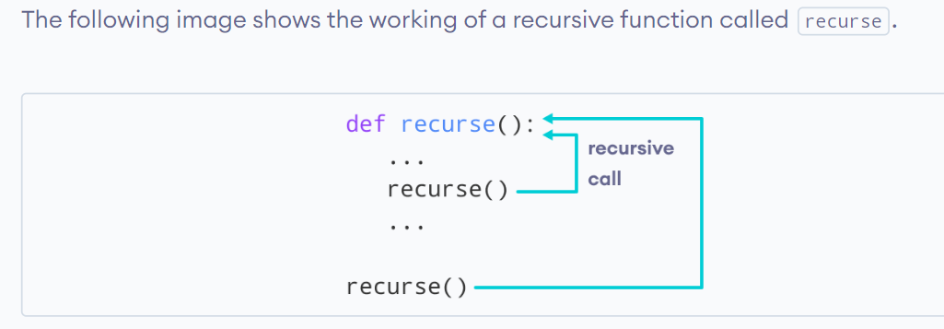
Python Recursion
Recursion is the process of defining something in terms of itself.
Python Recursive Function
In Python, we know that a function can call other functions. It is even possible for the function to call itself. These types of construct are termed as recursive functions.

Slide 36
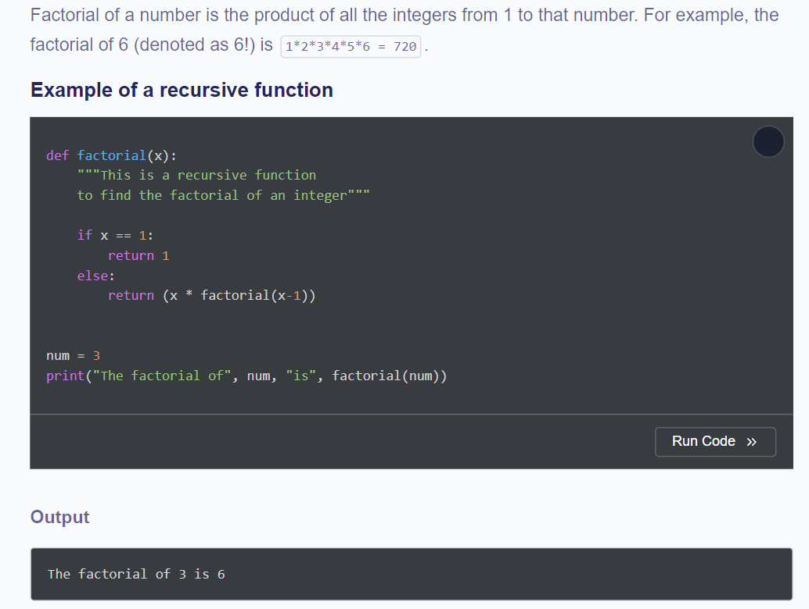

Slide 37
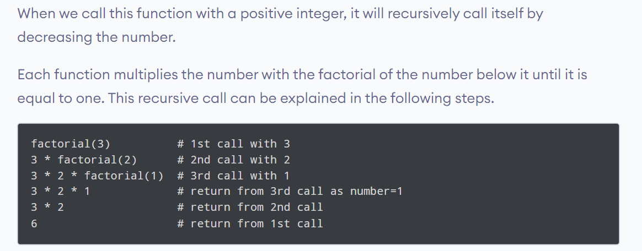

Slide 38
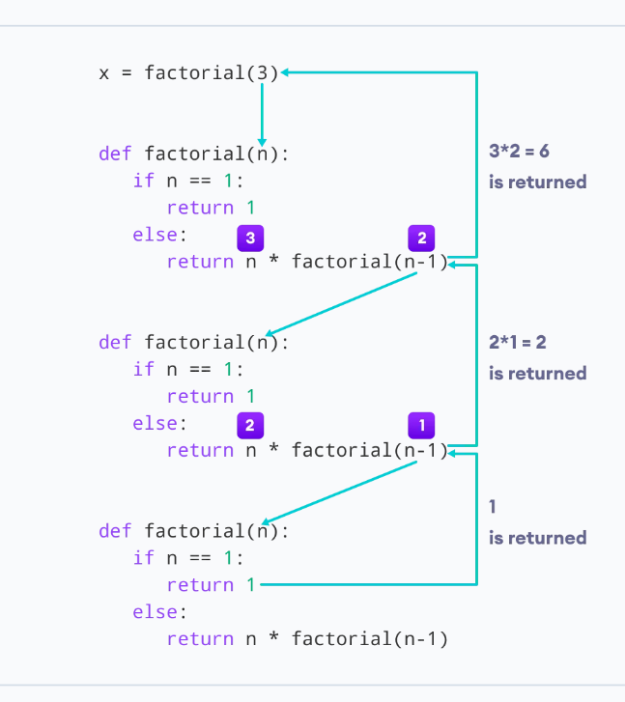

Slide 39
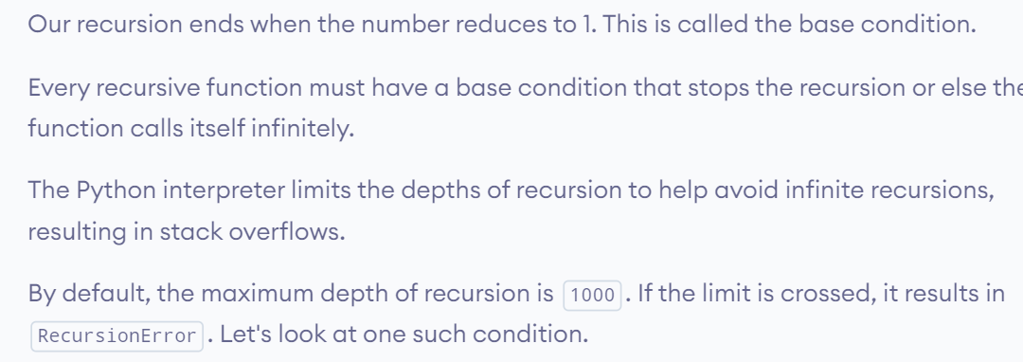

Slide 40
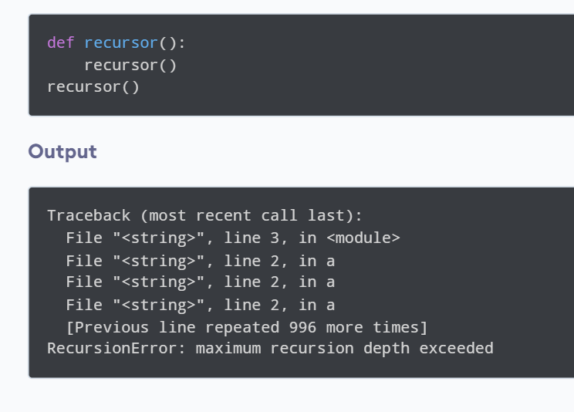

Slide 41
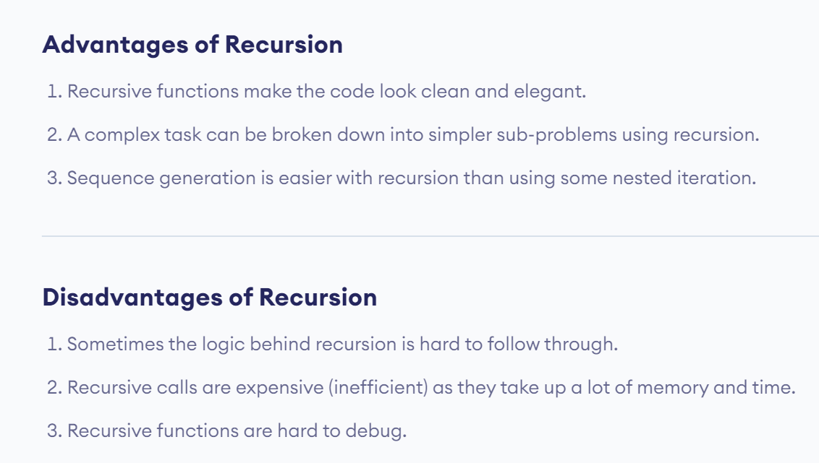

Slide 42
Call by Value
It is a way of passing arguments to a function in which the arguments get copied to the formal parameters of a function and are stored in different memory locations.
In short, Any changes made within the function are not reflected in the actual parameters of the function when called.

Slide 43
Call by Reference
It is a way of passing arguments to a function call in which both the actual argument and formal parameters refer to the same memory locations, and any changes made within the function are reflected in the actual parameters of the function when called.

Slide 44
Pass by Reference vs Value in Python
If we consider call by value and call by reference in Python, then we must keep in mind that,
Python variables are not storage containers. Rather Python’s variables are like memory references. They refer to the memory address where the value is stored.

Slide 45
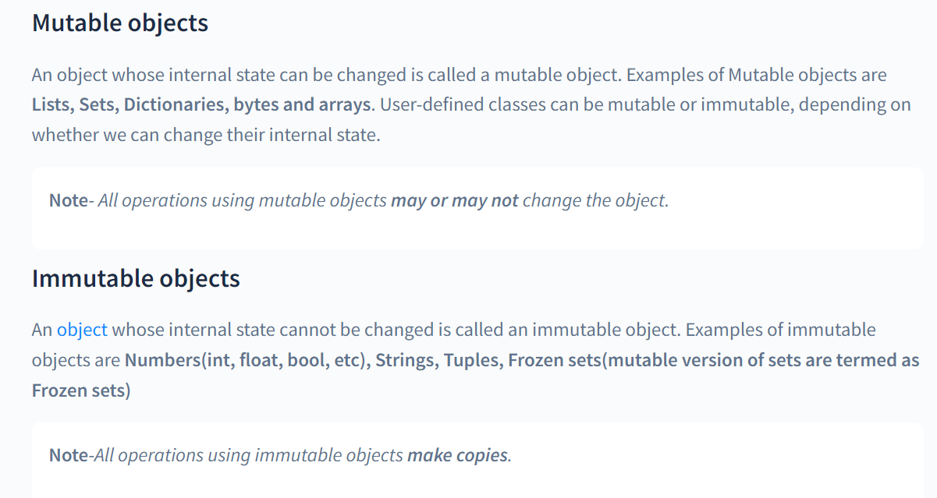

Slide 46
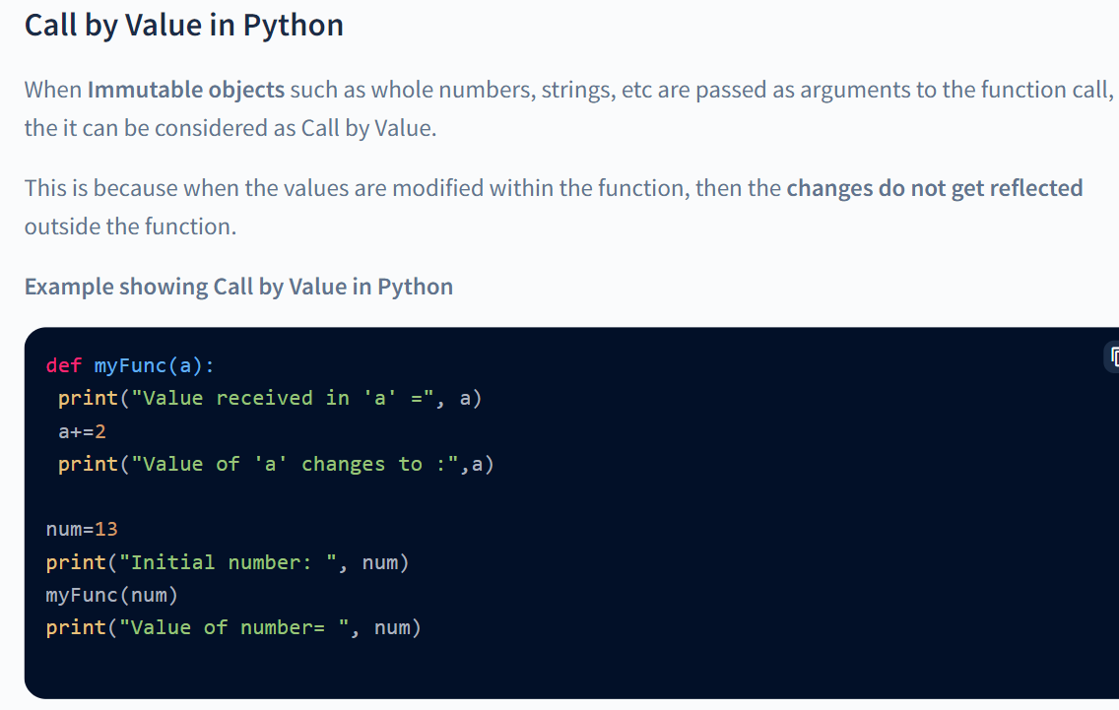

Slide 47
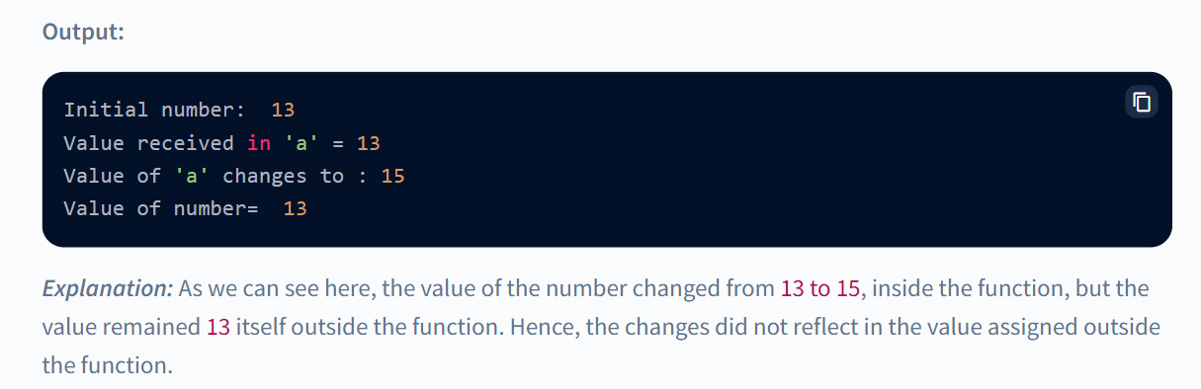

Slide 48
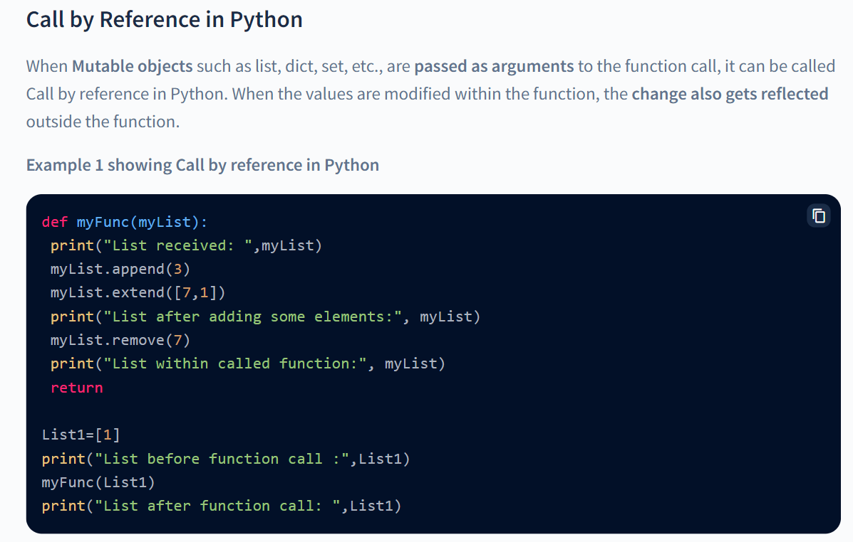

Slide 49
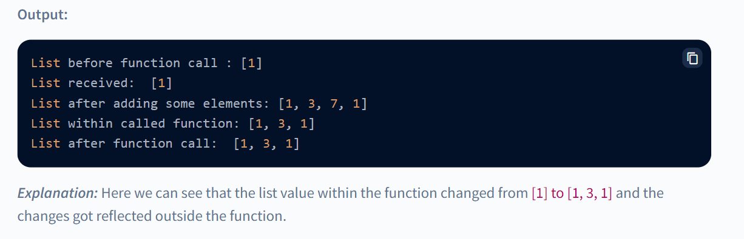

Slide 50
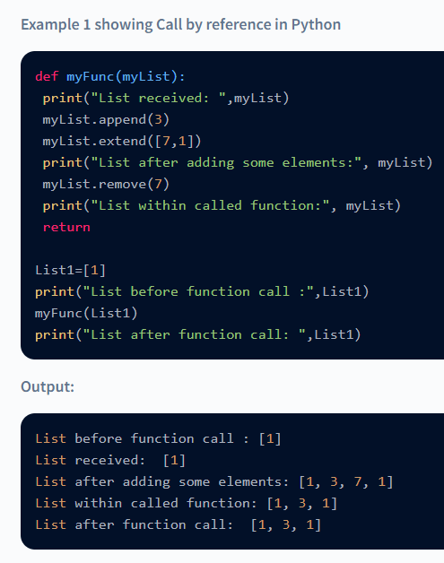
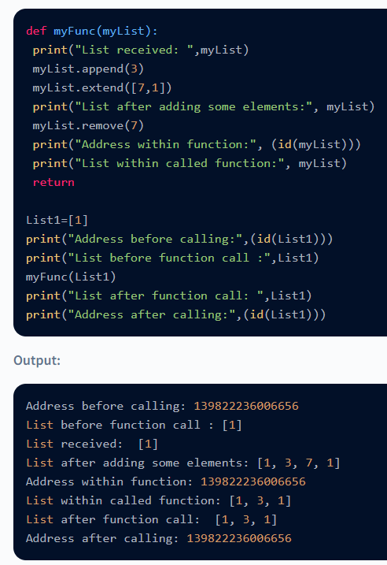

Slide 51
Explanation: Here we see the value of the list before calling the function, within the function and after calling the function gets stored in the same memory address. Hence, changes made within function gets reflected outside the function as well.

Slide 52
What do we infer?
Well, we see that when mutable objects are passed as arguments to a function then there are two cases:
a.) Change is reflected outside function
This is when a mutable object is passed as argument and no new value is assigned to it, ie.,the values refer to the same memory address.
b.) Change is not reflected outside function
This is when a mutable object is passed as argument and new values or datatype is assigned to it within the function, i.e. when the values outside the function and the values assigned within function refer to different memory addresses.

Slide 53
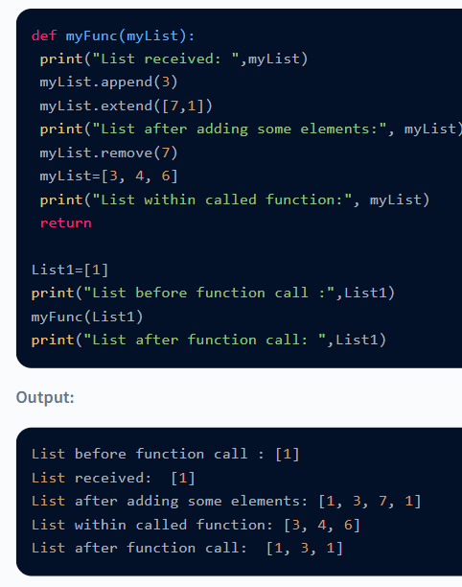
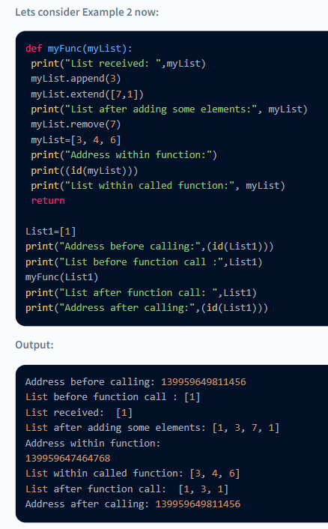

Slide 54
Explanation: Here we see that, the address of the list changes when new values are assigned to it within the function but outside the function, the value still refers to the previous memory allocation.
Hence, the changes made within the function do not get reflected outside the function.

Slide 55
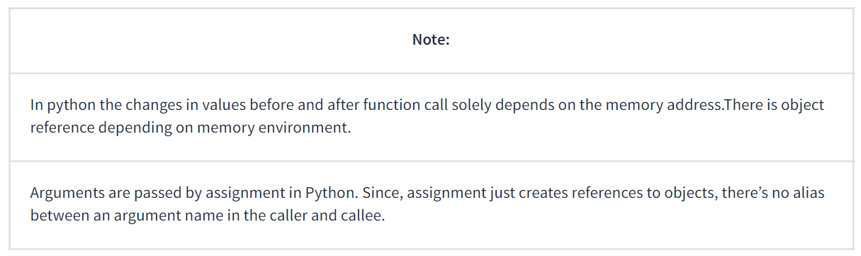

Slide 56
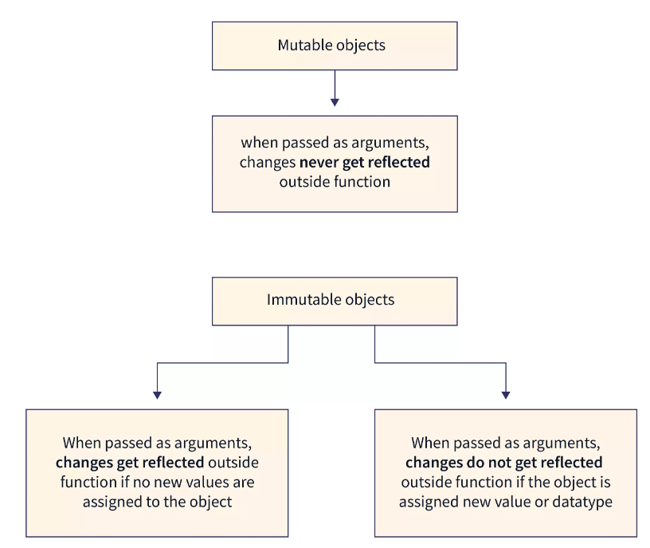

Slide 57
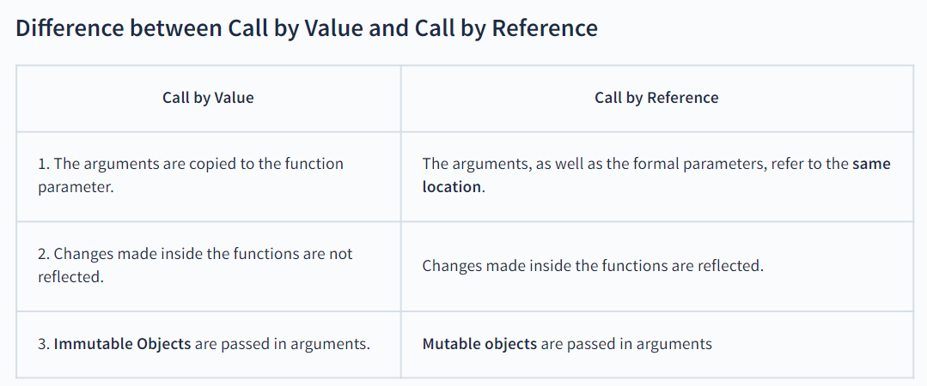

Slide 58
Conclusion
Depending upon the mutability/immutability of it's data type, a variable behaves differently.
If a variable refers to an immutable type, then any change in its value will also change the memory address it refers to. Still, if a variable refers to a mutable type, any change in the value of the mutable type will not change the memory address of the variable.
Arguments are passed by assignment in Python. The assignment creates references to objects.
Hence, Immutable objects passed as arguments are referred as in Call by Value and Mutable objects, when passed as arguments are referred to as Call by Reference.

